Slide 1

AI Resume
Matcher
Match your resume with the right job in seconds.
Resume Matcher | Resume Builder | ATS Score Checker
Hackathon Prototype

Slide 2



Job seekers apply blind
No feedback on fit
Filters you never see
One resume for every job
You can't tell how closely your resume matches a specific role.
Resumes can be screened by software before a person reads them.
A generic resume misses the keywords each job description asks for.
We show the gap, and how to close it, in seconds.
AI Resume Matcher — Hackathon Prototype

Slide 3



One toolkit, three tools
AI Resume Matcher
Resume Builder
ATS Score Checker
Scores your fit against a job description across skills, keywords, experience and education.
Build an ATS-friendly resume with a live preview and three clean templates.
Weighted checks from 0 to 100, with a clear fix for every issue found.
AI Resume Matcher — Hackathon Prototype

Slide 4
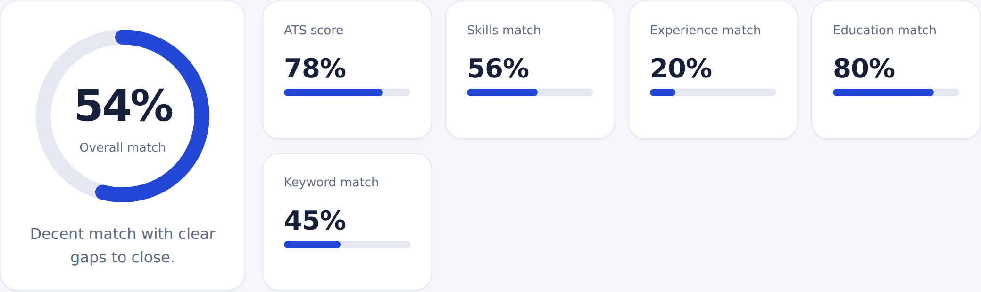
See your match at a glance
54%
Gaps found
~2 seconds
Overall match: Data Science student applying to Junior Data Analyst
Tableau, Power BI, A/B testing, Looker, Google Analytics and more
From pasted text to a full report, with no sign-up
AI Resume Matcher — Hackathon Prototype

Slide 5
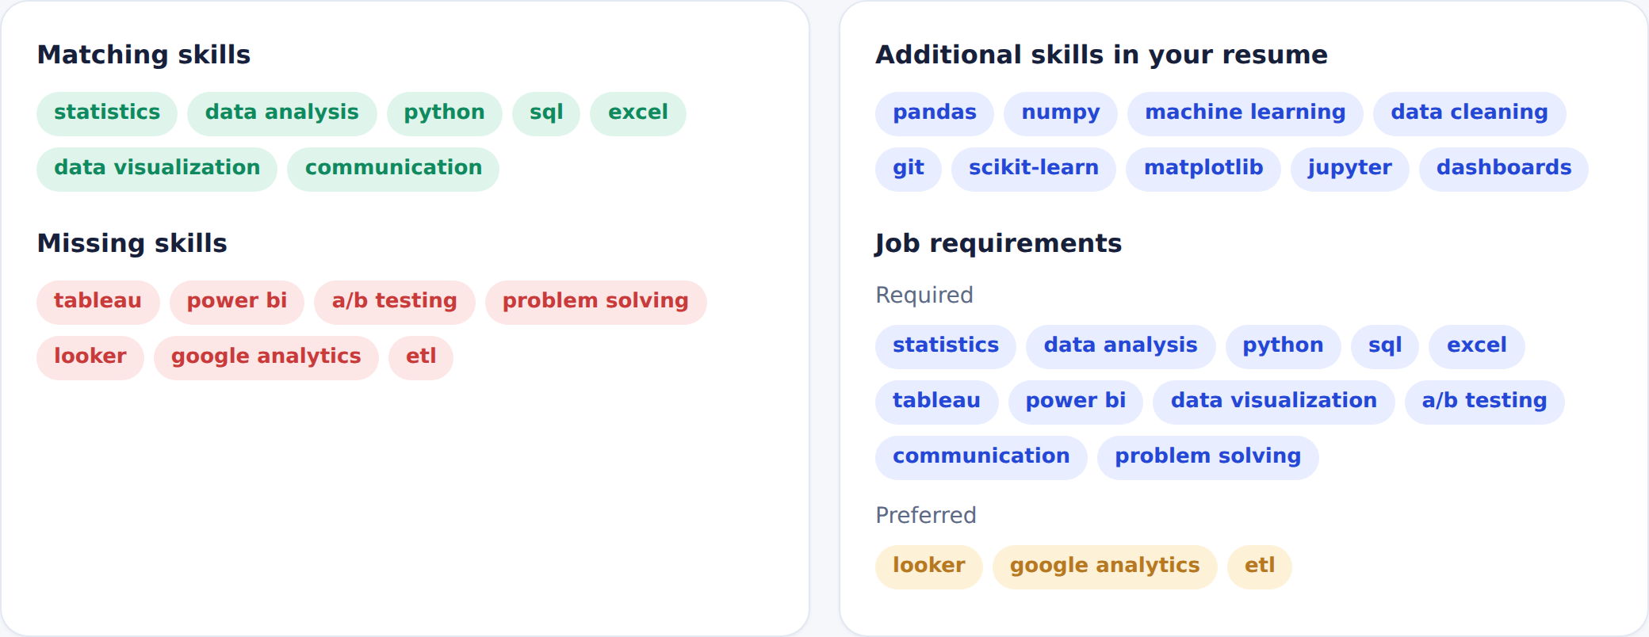
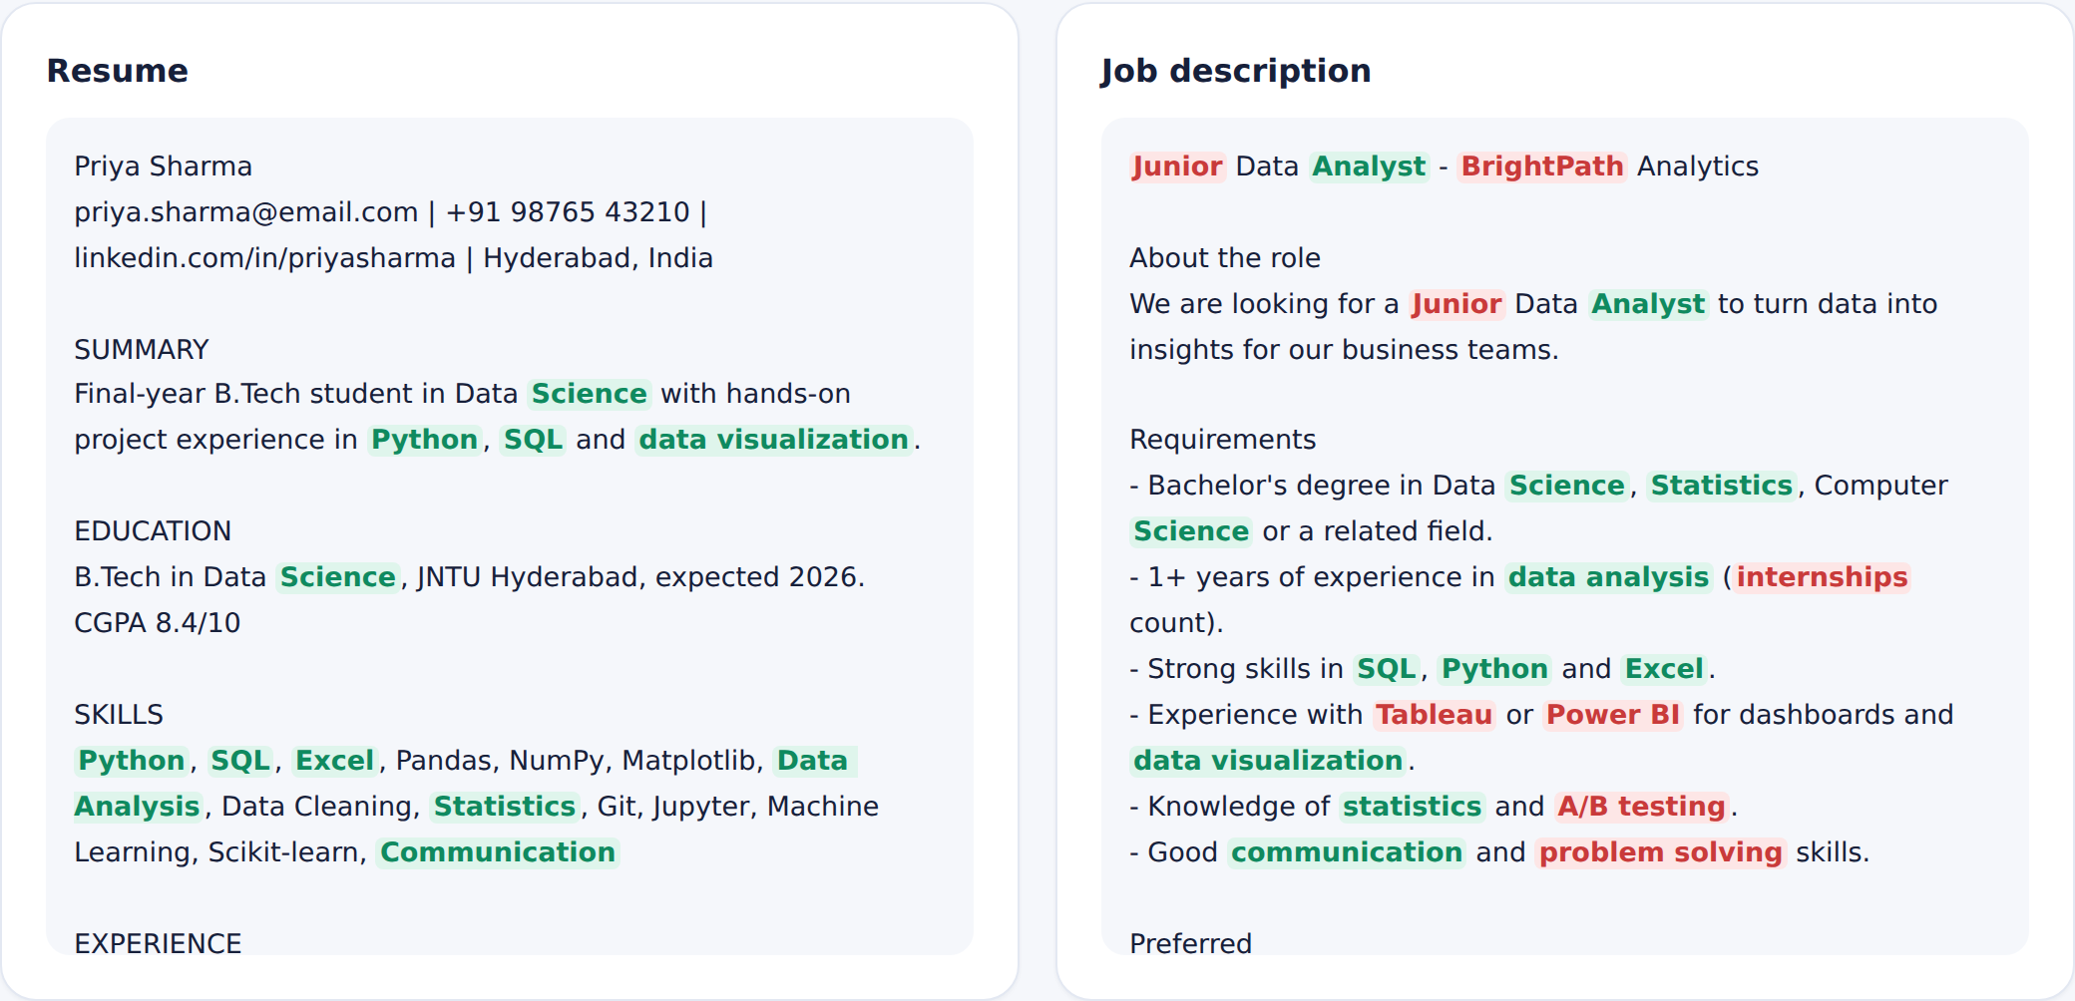
Know exactly what's missing
Matching and missing skills
Keywords pulled from the job description
Side-by-side view: green = matched, red = missing
Requirements your resume doesn't address yet
AI Resume Matcher — Hackathon Prototype

Slide 6
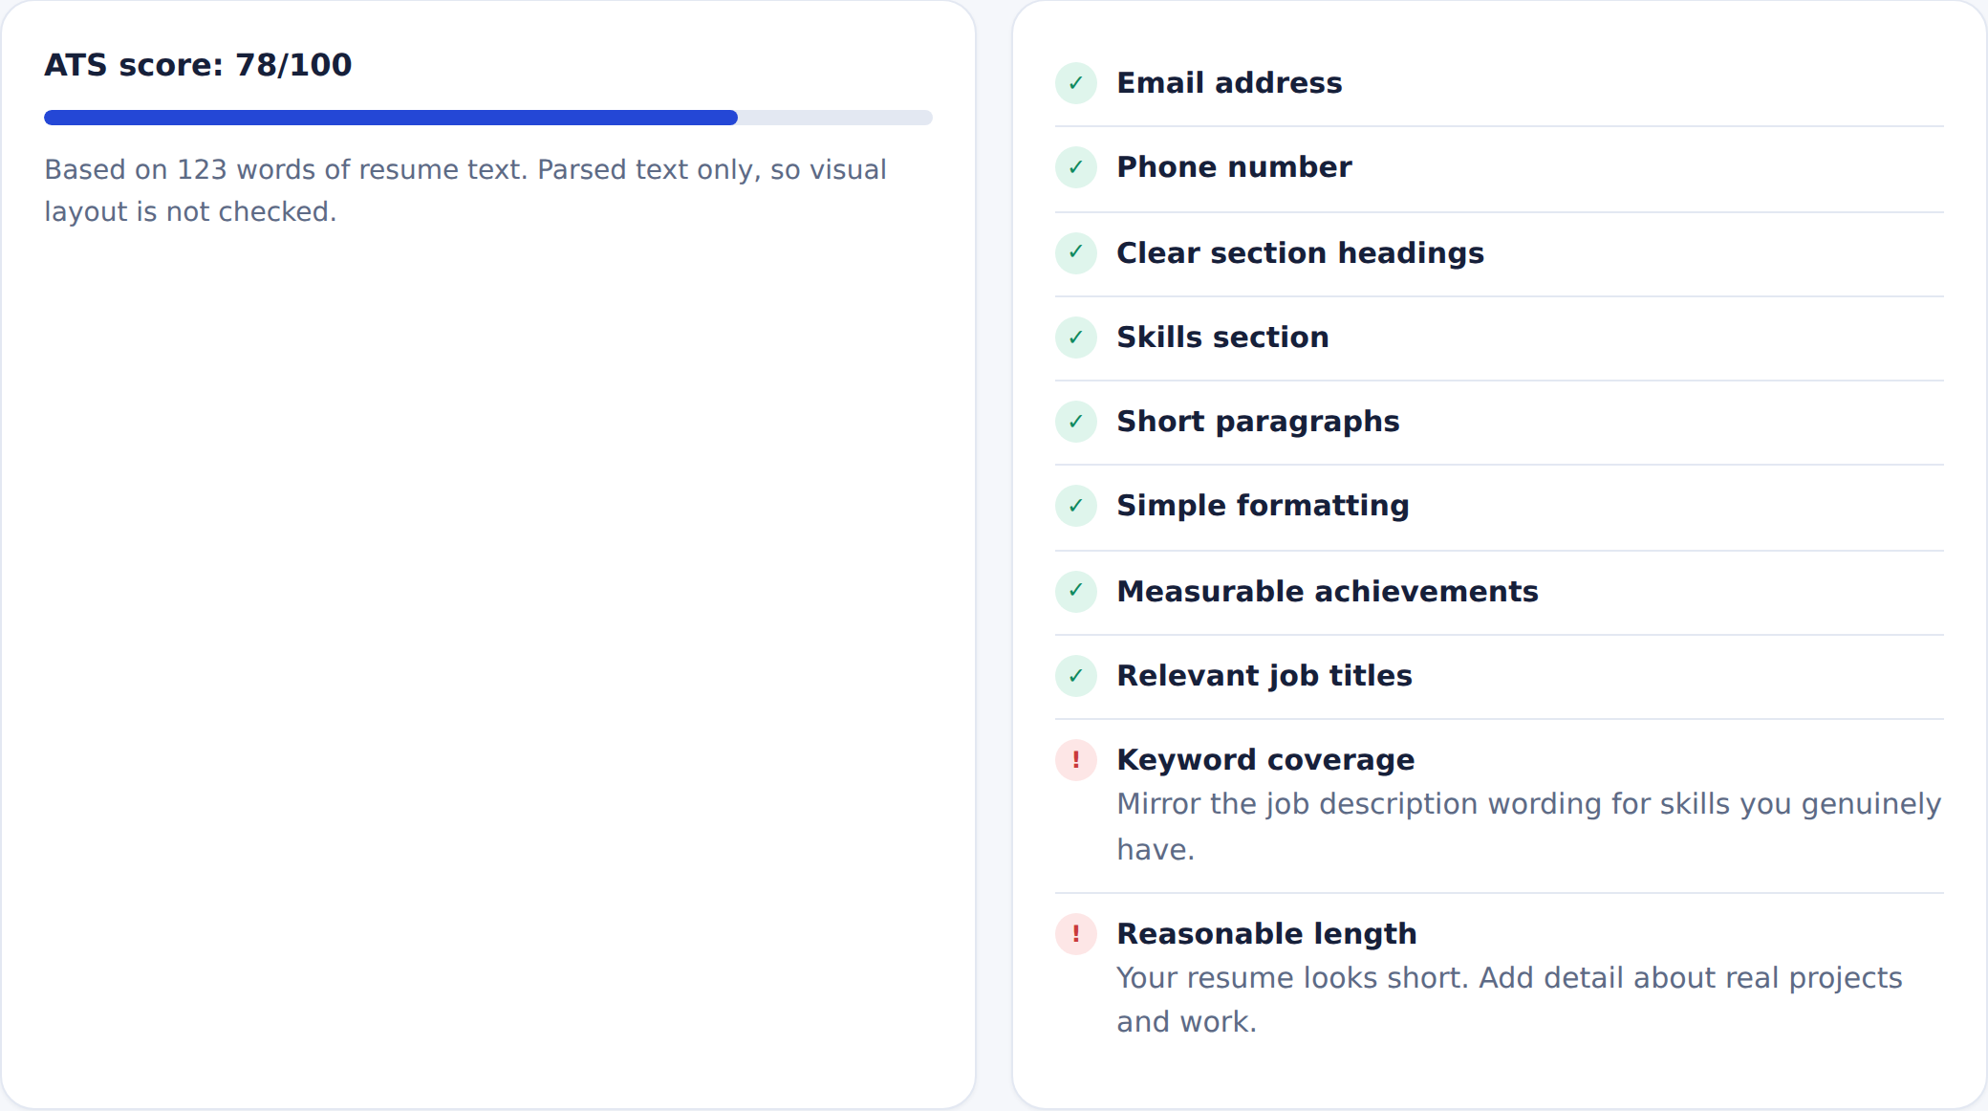
ATS score and resume builder
ResumeForge builder
Editor for every resume section
Live preview, 3 ATS-friendly templates
Score updates as you type
Paste a job description to check keywords
Try Demo, Import text, Download PDF
ATS Check tab: every failed check comes with a fix.
AI Resume Matcher — Hackathon Prototype

Slide 7
How it works, and how we keep it honest
Parse
›
Extract
›
Compare
›
Score
›
Suggest
PDF, DOCX or text
Skills, years, education
Against the job
Weighted 0-100
Honest next steps
Responsible by design
Next steps
Never invents skills or experience
API keys stay on the server
Resumes are not stored
Model-based scoring with Claude API
OCR for scanned PDFs
More roles and skill libraries
AI Resume Matcher — Hackathon Prototype

